Slide 1
VMware installing ESXi using PXE

Slide 2


Server Information
Hostname ::
mtkpxe01
Server IP in ilo ::
172.21.151.192
Hostname ::
mtkpxe02
Server IP in ilo ::
172.21.203.30
Account ::
root
Passwd ::
it那組
Account ::
root
Passwd ::
it那組
Location ::
A 棟
Location ::
C 棟

Slide 3
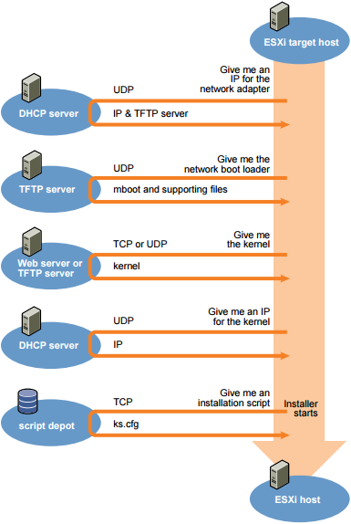
OverView
The target host makes a DHCP request.
DHCP server responds with the IP information and the location of the TFTP server.
Host contacts the TFTP server and requests the file that the DHCP server specified.
TFTP server sends the network boot loader, and the host executes it. The initial boot loader might load additional boot loader components from the TFTP server.
Boot loader searches for a configuration file on the TFTP, downloads the kernel and other ESXi Components from the TFTP and boots the Kernel .
Installer using a kickstart script.
3
Notes:
3

Slide 4
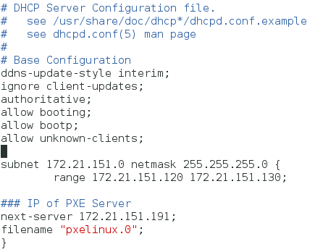
Install & Configure DHCP in CentOS 7
1. Install DHCP
#yum –y install dhcp
2. configure dhcp
#vim /etc/dhcp/dhcpd.conf
3. start dchp
#systemctl start dhcpd
4. start automatically
#systemctl enable dhcpd

Slide 5
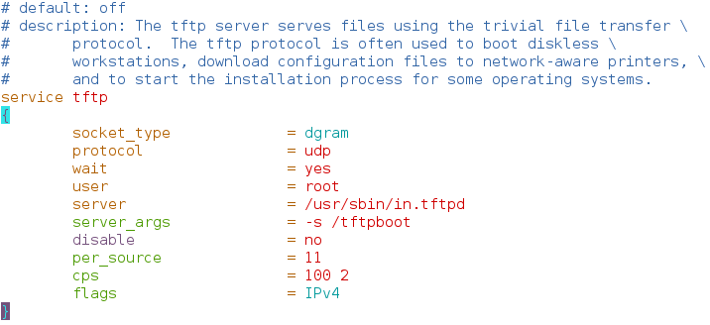
Install & Configure TFTP
1. Install TFTP & xinetd
#yum –y install tftp-server xinetd
2. change TFTP file parameter
disable yes to no & server_args=tftp path
#vim /etc/xinetd.d/tftp
3. start & auto TFTP & xinetd
#systemctl start/enable tftpd
#systemctl start/enable xinetd

Slide 6
Copy PXE boot loader files
1. install syslinux
#yum –y install syslinux
2. create TFTP root directory
#mkdir /tftpboot
3. copy required network boot file to TFTP root directory
#cp /usr/share/syslinux/pxelinux.0 /tftpboot
#cp /usr/share/syslinux/menu.c32 /tftpboot
Notes:
6

Slide 7
Copy ESXi ISO resource to local
1. mount ESXi ISO
#mount –a
2. create folder
#mkdir /tftpboot/ESXi_5.1.0.2323236
3. copy all the files contents from *** to /tftpboot/ESXi_5.1.0.2323236
#cp - r **** /tftpboot/ESXi_5.1.0.2323236
4. set permission to folder
#chmod –R 755 ESXi_5.1.0.2323236

Slide 8
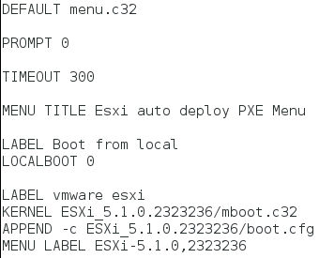
Configure PXE menu
1. create PXE menu folder
#mkdir –p /tftpboot/pxelinux.cfg
2. create PXE menu file
#cd /tftpboot/pxelinux.cfg
#vim default

Slide 9
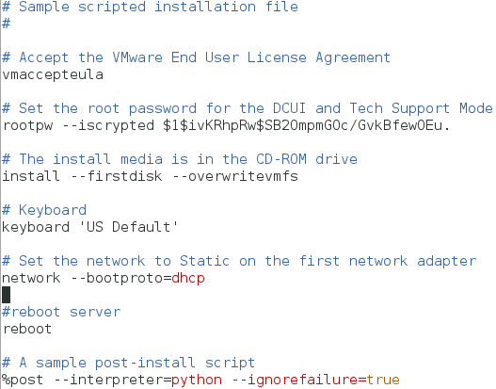
Put & Modify kickstart script in server
The default sample ks.cfg file is located in the ESXi Host at /etc/vmware/weasel/ks.cfg . Copy ks.cfg to server
Modify ks.cfg
1.change root passwd
#openssl passwd -1
cpoy passwrd
add in rootpw
2.change keyboard
use ‘US Default’
3.change network
bootproto=dhcp/static

Slide 10
Start NFS share kickstart script
1. start nfs
#systemctl start/enable nfs
2. create folder
#mkdir -p /var/lib/tftpboot/ESXi_5.1.0.2323236
3. configure nfs import Kickstart
#vim /etc/exports
4. put ks.cfg file in the /var/lib/tftpboot/ESXi_5.1.0.2323236

Slide 11
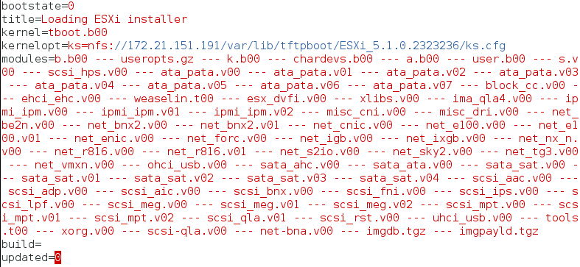
Modify the boot.cfg
1. #vim /tftpboot/ESXi_5.1.0.2323236
change Kernel & modules path , kernelopt kickstart share path

Slide 12
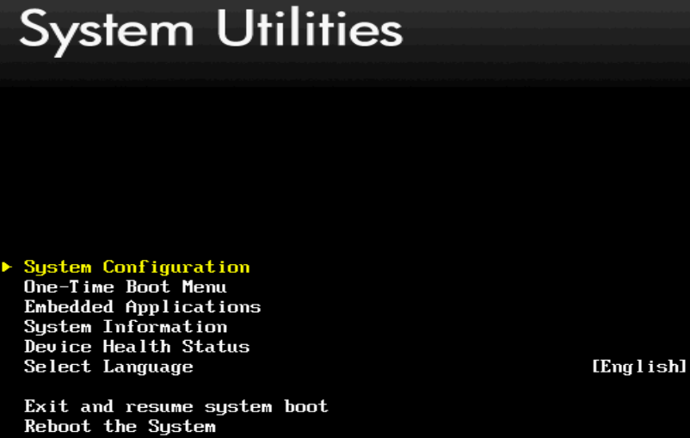
Change BIOS mode to PXE boot (1)
Example on HP 560 Gen9 server , Power on and Select F9 get to the BIOS.
1. Selcet System Configuration

Slide 13
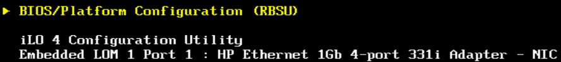
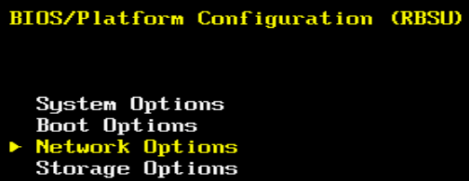
Change BIOS mode to PXE boot (2)
2. Selcet BIOS/Platform Configuration (RBSU)
3. Selcet Network Options

Slide 14
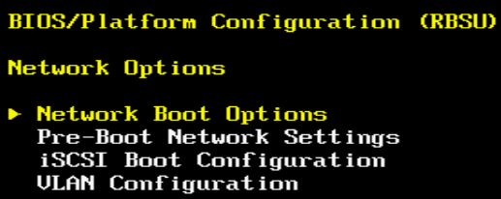
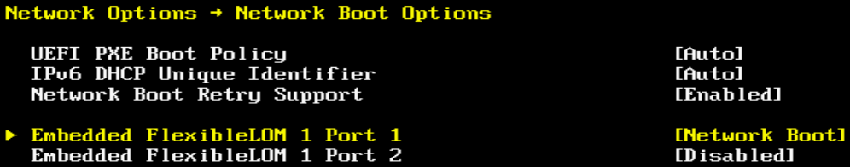
Change BIOS mode to PXE boot (3)
4. Selcet Network Boot Options
5. Verify only one NIC is enabled then hit esc out to BIOS platform

Slide 15
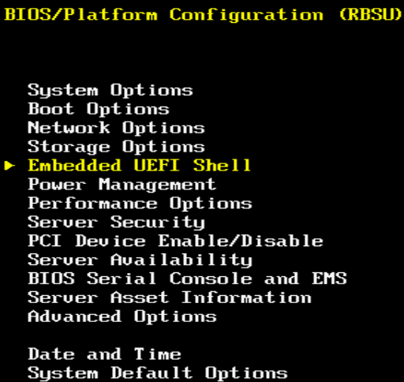
Change BIOS mode to PXE boot (4)
4. Selcet Embedded UEFI Shell

Slide 16
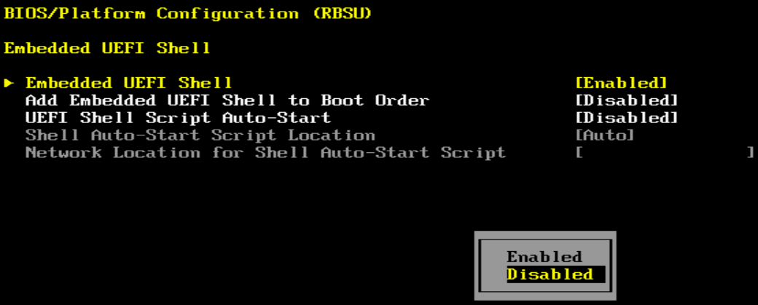
Change BIOS mode to PXE boot (5)
6. Change Embedded UEFI Shell to Disabled , Back out to BIOS platform

Slide 17
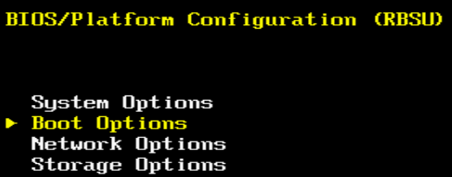
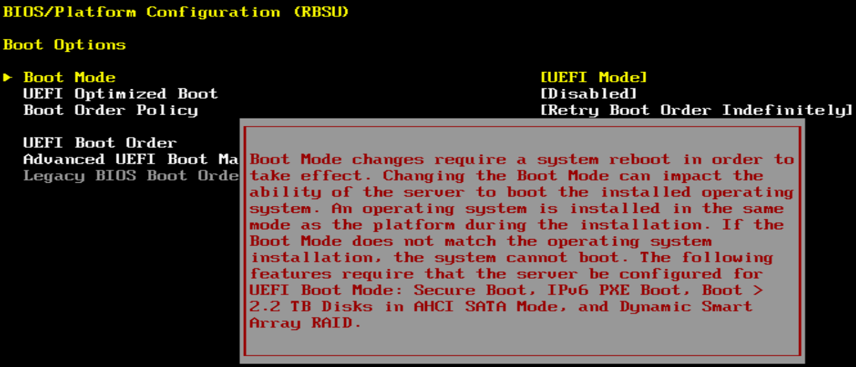
Change BIOS mode to PXE boot (6)
4. Selcet Boot Options
5. Change Boot Mode, hit enter to get rid of warning message

Slide 18
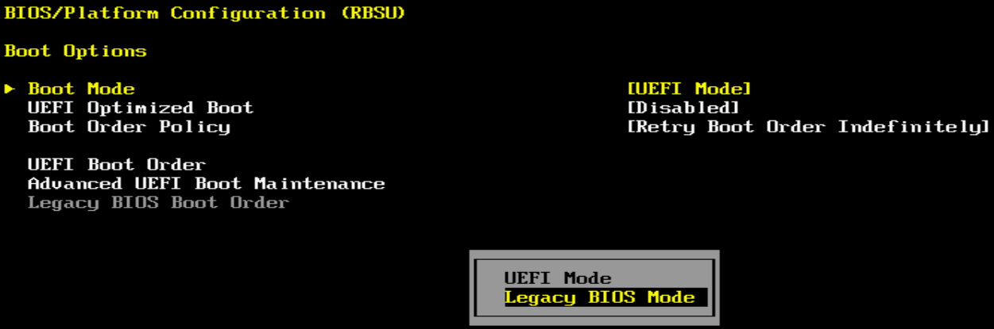
Change BIOS mode to PXE boot (7)
6. Change Boot Mode to Legacy BIOS Mode and then reboot server

Slide 19

Demo

Slide 20
END

